Slide 1
Mid-Term Study Guide
CMSC 471

Slide 2
Agents
How do you design an intelligent agent?
What are rational agents?
Agent types
Properties of Environments: Describe the properties of a given problem space

Slide 3
Search
Represent problem as state, action
Search Strategies:
Uninformed
Informed
Properties of Searching Strategies
Cost of path found
Heuristics
Hill Climbing

Slide 4
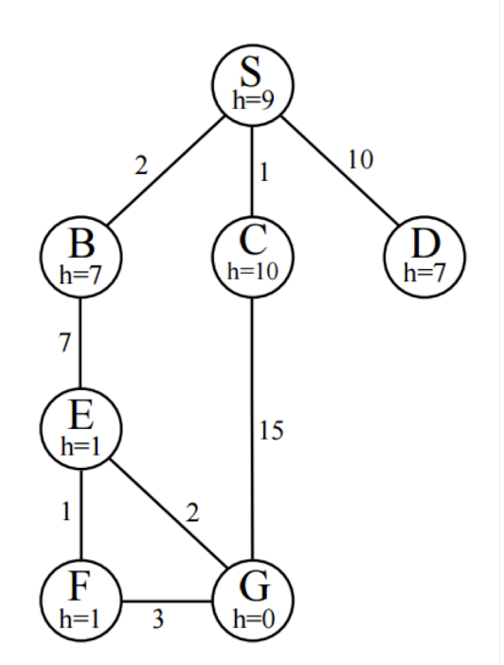
Sample Search Question
For each of the following search strategies, give the list of expanded nodes:
DF
DFID
Cost of Path returned
Branching factor
Is the heuristic as shown for this graph admissible? Explain why or why not.

Slide 5
Sample Search Question
For each of the following search strategies, give the list of expanded nodes:
DF : S-B-E-F(-G)
DFID : S-S-B-C-D-S-B-E(-G)
Cost of Path returned:
DF: 13
DFID : 16
Branching factor : 3
Is the heuristic as shown for this graph admissible? Explain why or why not. : Yes

Slide 6
Constraints
Problem as Constraint Network
CSP strategies:
Backtracking
Forward Checking
Arc Consistency
Most constraining variable
Least constraining value
Also:
Splitting
Variable Elimination
Local Search
Pay attention to how these strategies work
Map Coloring Example

Slide 7
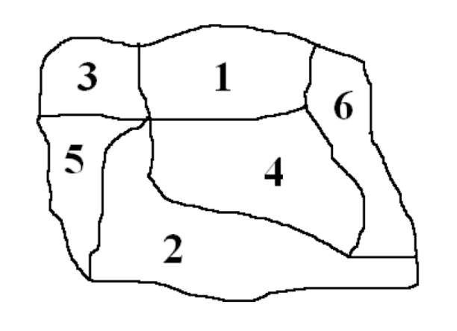
Sample Constraint Questions
Identify the variables that should be used to set this up as a CSP problem and the domain of possible values for each variable.
Draw a constraint graph for this problem.
Assume the initial domains of the regions in the map above are given as:
1={R,G,B}, 2={R,G}, 3={R,G,B}, 4={R}, 5={R,G,B}, and 6={R}
What is the result of applying the Arc Consistency algorithm, AC-3?
Is a solution possible from this state?

Slide 8
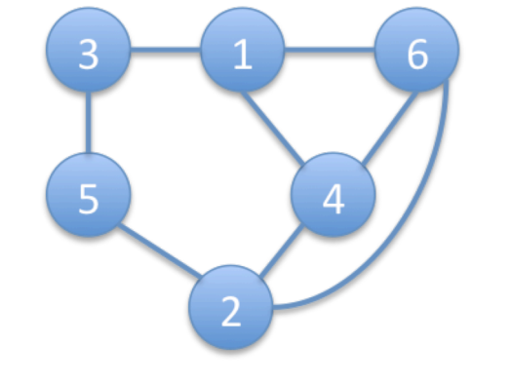
Sample Constraint Questions
There are six variables, which we could name as 1,2,3,4,5,6.
The domain of each is {R, G, B}.
There are two possible answers:
1={G, B}, 2={G}, 3={R, G, B}, 4={R}, 5={R, B}, 6={}
1={G, B}, 2={G}, 3={R, G, B}, 4={} 5={R, B}, 6={R}
No solution is possible

Slide 9
Logic
Remember:
Knowledge base
Entail
Model
Soundness/Completeness
Propositional Logic:
Syntax
Rules of Inference
Resolution by Refutation
FOL
Syntax
Translating English to FOL

